Slide 1
ASSIGNMENT 2
Qualification | BTEC Level 5 HND Diploma in Computing
Unit number and title | Unit 14: Business Intelligence
Submission date |  | Date Received 1st submission
Re-submission Date |  | Date Received 2nd submission
Student Name | Ngo Tuan Anh | Student ID | GCH190543
Class | GCH0803 | Assessor name | Doan Trung Tung
Student declaration I certify that the assignment submission is entirely my own work and I fully understand the consequences of plagiarism. I understand that making a false declaration is a form of malpractice.
 |  | Student’s signature

Slide 2
Grading grid
P3 | P4 | P5 | P6 | M3 | M4 | D3 | D4
❒ Summative Feedback: ❒ Resubmission Feedback:
Grade: | Assessor Signature: | Date:
IV Signature:

Slide 3
E-commerce fashion
Nguyen Dang Khoa
Ngo Tuan Anh
Luong Ngoc Thai
Nguyen Vu Thai
Le Quoc Thai

Slide 4
What is BI?
BI (Business Intelligence) is a set of processes, architectures, and technologies that convert raw data into meaningful information that drives profitable business actions. It is a suite of software and services to transform data into actionable intelligence and knowledge. BI has a direct influence on the strategic, tactical, and operational business choices made by a company. BI encourages fact-based decision-making based on previous data rather than guesswork and intuition.

Slide 5
Real examples of how to apply BI on business
A hotel owner uses BI analytical applications to gather statistical information regarding average occupancy and room rate. It helps to find aggregate revenue generated per room.
It also collects statistics on market share and data from customer surveys from each hotel to decides its competitive position in various markets.
By analyzing these trends year by year, month by month and day by day helps management to offer discounts on room rentals.

Slide 6
BI techniques
Querying
a request for specific data or information from a database
Data Visualization
the visualization of data in charts is a convenient way to immediately understand how to interpret the data.
Reporting
BI-first reports efficiently collect and present information to support management, planning, and decision-making.
Data Mining
Data mining is a computer supported method to reveal previously unknown or unnoticed relations among data entities.
Predictive Techniques
On-line Analytical Processing (OLAP)
Based on the historical data, we may also endeavor to predict future trends or outcomes.
user can navigate to another OLAP cube to see the relations on another dimension(s). All the functionality is provided in real-time.
Statistical Analysis
Statistical analysis is used for devising and analyzing the results from data mining.

Slide 7
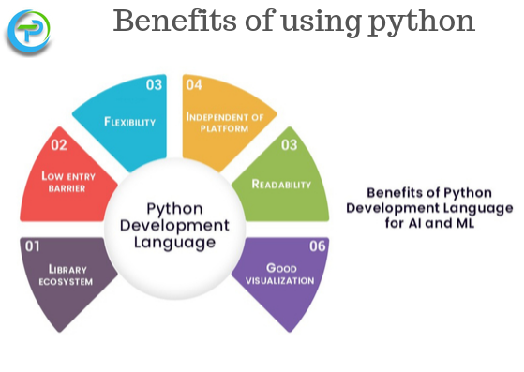
BI tools (Python)
Guido Van Rossum designed Python, a sophisticated, high-level, object-oriented programming language. It's simple to pick up and is quickly becoming one of the finest beginning programming languages for beginners. Python employs automatic memory allocation and is totally dynamically typed. Python features sophisticated high-level data structures and an object-oriented programming paradigm that is both easy and effective. Python's command syntax is a significant benefit, since its clarity, ease of comprehension, and flexible typing make it a perfect language for scripting and application development across a wide range of sectors and platforms.
There are many libraries in Python for numerical science and computing, such as SciPy and NumPy, which are used for general purposes in computing. And, there are specific libraries like: EarthPy for earth science, AstroPy for Astronomy,... In addition, Python is also widely used in machine learning, data mining and deep learning.

Slide 8
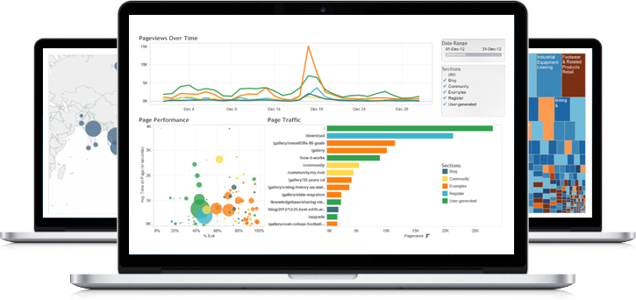
BI tools (tableau)
Tableau is a software created by a company of the same name in Washington, USA. This software is popularly used in the field of Business Intelligence. This software deals with data visualization, allowing developers to visually represent the data and information they collect. In this way, it makes the process of studying numerical data and drawing conclusions easier and smoother. They come in the format of dashboards and sheets.
The three most prominent features of Tableau are:
Real-time data analysis
Combine data
Data Collaboration
Tableau aids in the objective presentation of data. Simultaneously, this program assists users in making the most accurate trend forecasts. Algorithm-based analysis is used to do this. Tableau then builds a foundation to assist users in making the best decisions possible. The program aids in the retrieval of data in both raw and visualized formats.
Tableau gives users a lot of help when it comes to showing data on a map. This program stores a variety of data, including postal codes, location names, contact information, and so on. In addition, visual representations of the maps will be provided, such as a flow map, a heat map, a secret map score, and so on.
Tableau software can handle a variety of data sources, including cloud data, SQL and NoSQL data, files, and so on.

Slide 9
Datasets
The data in our dataset is about a successful online fashion store with more than 9 million registered users. This dataset includes identifierHash, type, country, language, socialNbFollowers, socialNbFollows, socialProductsLiked, productsListed, productsSold, productsPassRate, productsWished, productsBought, gender, civilityGenderId, civilityTitle, hasAnyApp, hasAndroidApp,hasIosApp, seniorLastLogin, daysSince seniorityAsYears, countryCode. However, this dataset still needs editing. First we will remove 3 columns: type, identifierHash,civilityGenderId. Second, Modify the data in the column gender, language to the correct type, avoiding abbreviations.. And finally, we'll round to the decimals of the senorityAsYears , senorityAsMonths columns.

Slide 10
Preprocess steps on datasets

Slide 11
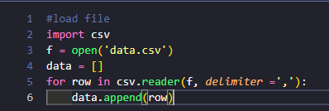
Preprocess steps on datasets
First of all we need to read the csv file.
First I will import csv module, then use open() function to read file. After this, I will use reader() function to read all row in file and add to data

Slide 12
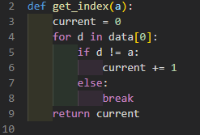
Preprocess steps on datasets
This function is use to get the index of column that you want edit
This function pass a parameter a, then creates a variable current to save the index, and then runs a for loop in the data. It will compare a with each element in the data row header and return current

Slide 13
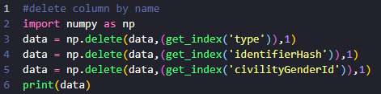
Preprocess steps on datasets
This function is using to delete column by name
Import the numpy library.Then using delete() function the to remove the column, the delete function will receive an array, the position to be deleted (Get it by the get_index function), and the last parameter equal to 1 is the collumn (which is the row if equal to 0).

Slide 14
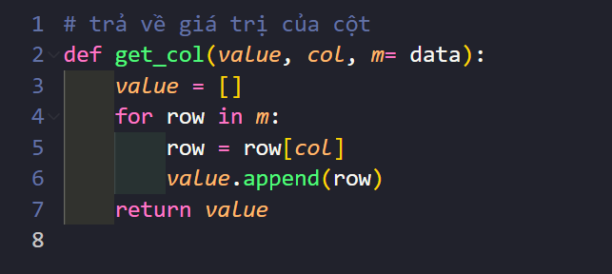
Preprocess steps on datasets
The purpose of this function is to get the data of a column.
This function takes 3 parameters, the third parameter is the default parameter with the data of the file that we get. In this function will run a for loop in the data array and then find out which column has the same position as the second argument passed. Then append that column to the given empty array.

Slide 15
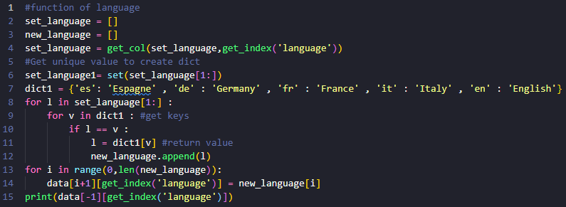
Preprocess steps on datasets
This function's purpose is to convert the words in the language column from abbreviations to full writing
Create two new empty arrays, set_language and new_language. Set_language will be equal to the language column in data. Create a dictionary containing the key as the abbreviation and the value as the full name of the language. Run the for loop in the set language from position 1 (ignoring the header). Run the for loop in the dictionary dict1. Compare the word element of the language column with the key word in the dictionary. If they are equal, append the value of that key to the new array. After finishing we get the new_language array with the non-abbreviated letters. Replace the new_language array in the language column of data.

Slide 16
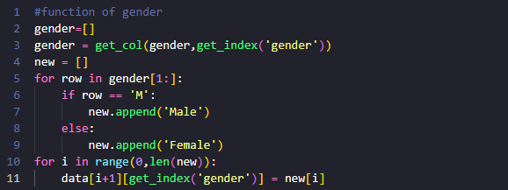
Preprocess steps on datasets
The purpose of this function is to convert the abbreviated gender into full text
Create an empty gender array and assign it equal to the gender column in the data using the get_col function. Create a new array to assign the new value you want to change into. Let the for loop run through the gender array, for any element with a value equal to 'M', append the value 'Male' to new and otherwise append 'Female'. Once done, we get a new array with gender as the full text. Then replace the new array with the gender column in data.

Slide 17
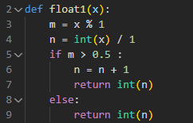
Preprocess steps on datasets
This function's purpose is to round numbers of type float
Take the x, x % 1 parameter to get the decimal part. int(x) / 1 is for getting the integer part. If the decimal part is greater than 5 then increment the integer part by 1, otherwise keep the integer part.

Slide 18
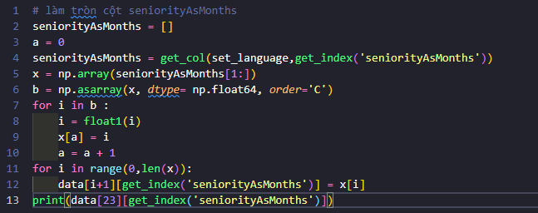
Preprocess steps on datasets
Rounding senorityAsMonths column
Generate a =0, assign senorityAsMonths to the senorityAsMonths column in data. Since I want to convert the data to float, I will turn senorityAsMonths into an array of numpy and convert to float64 using the asarray function. Then run a for loop in the newly obtained array after converting to convert all to integers by function float1() . Then replace the new array in the senorityAsMonths column to get the rounded numbers.

Slide 19
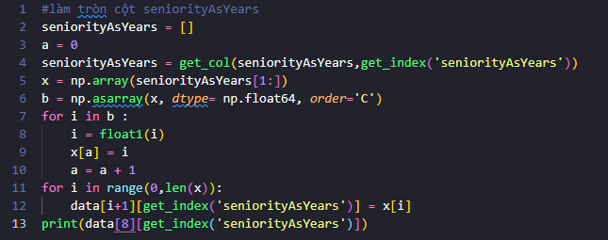
Preprocess steps on datasets
Rounding senorityAsYears column
Generate a =0, assign senorityAsYears to the senorityAsYears column in data. Since I want to convert the data to float, I will turn senorityAsMonths into an array of numpy and convert to float64 using the as array() function. Then run a for loop in the newly obtained array after converting to convert all to integers by function float1(). Then replace the new array in the senorityAsYears column to get the rounded numbers.

Slide 20
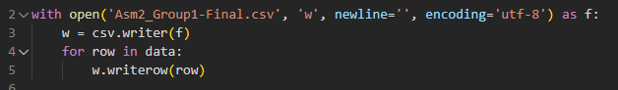
Preprocess steps on datasets
Last step, output another file
Then create a new file with the name 'Asm2_Group1-Final.csv' using the open() function and write all the data's data to the new file using the for loop.

Slide 21
Dashboard 1
This dashboard displays products sold, products bought, gender and country. This table compares products sold and products bought for the country according to gender.

Slide 22
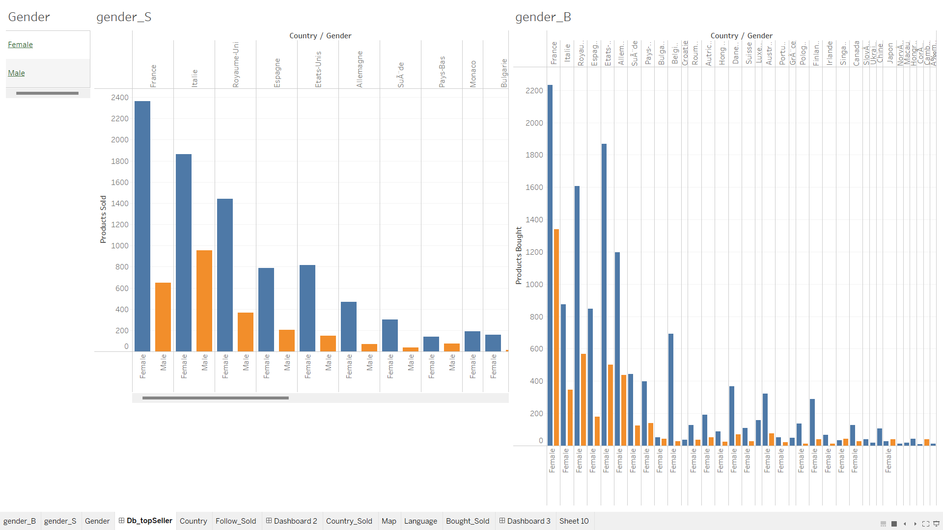

Slide 23
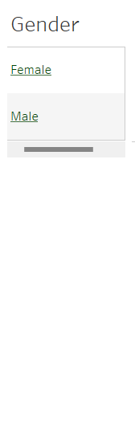
Gender chart
This chart is used to choose to compare female and male in the dashboards.

Slide 24
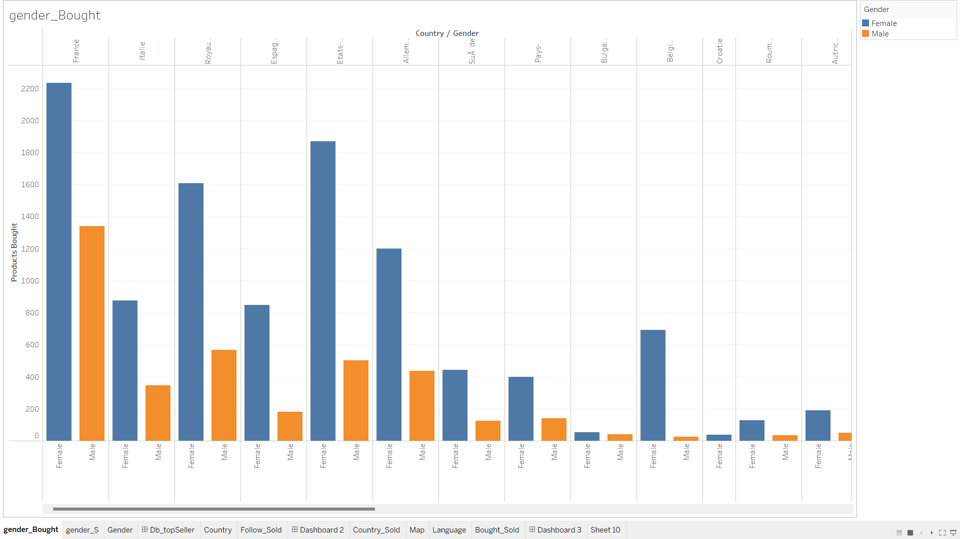
Gender_ Bought Chart
This chart helps to see the difference between products bought by each female or male in different countries.

Slide 25
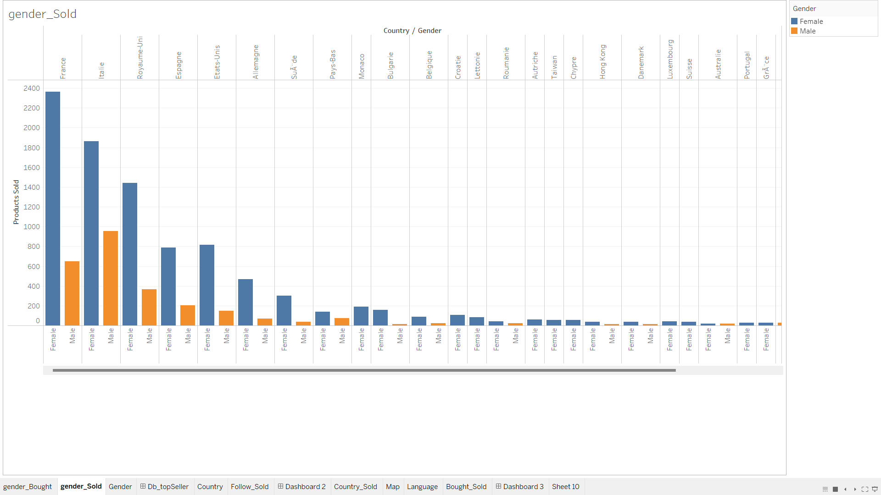
Gender_Sold Chart
This chart helps to see the difference between products sold by each female or male in different countries.

Slide 26
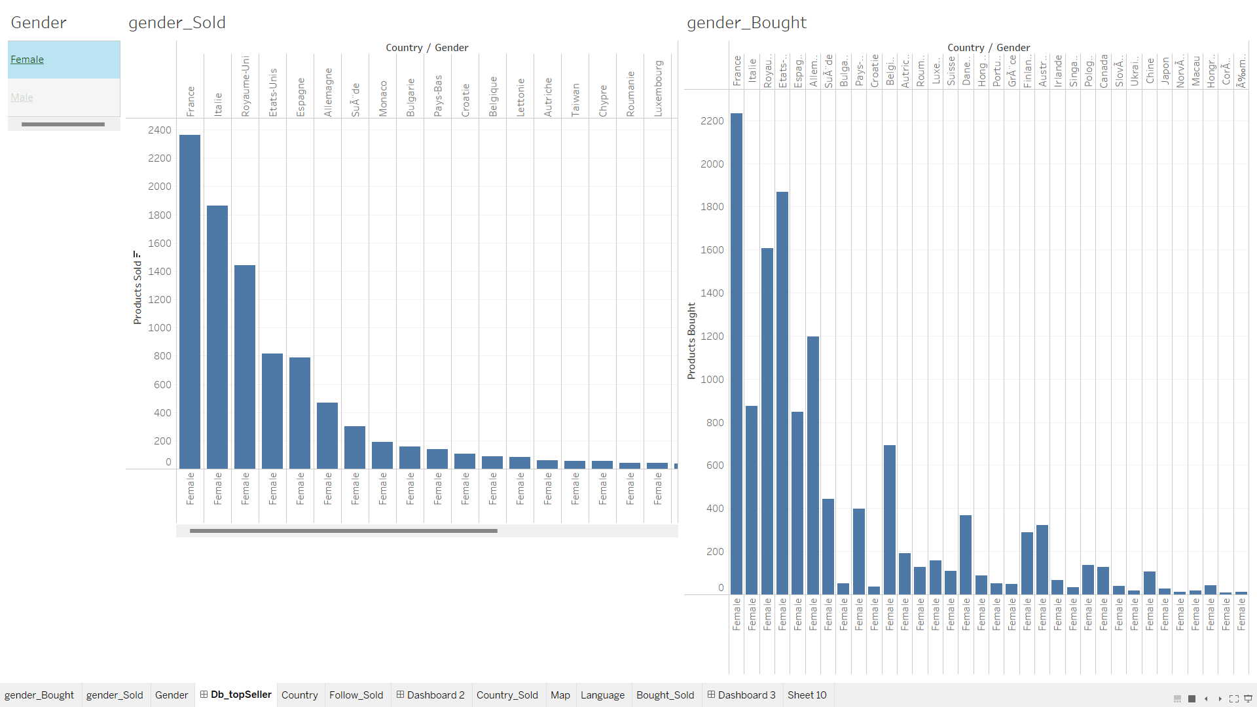
Dashboard Action
This is when moving the cursor to the gender, it will display general information in the products bought and products sold chart.

Slide 27
Dashboard 2
This dashboard socialNBFollowers and productsSold, gender, country, productsBought, socialNBFollows . This dashboard compares the number of followers and the number of productsSold, compares the number of follows and the number of productsBought, filtered by gender.

Slide 28
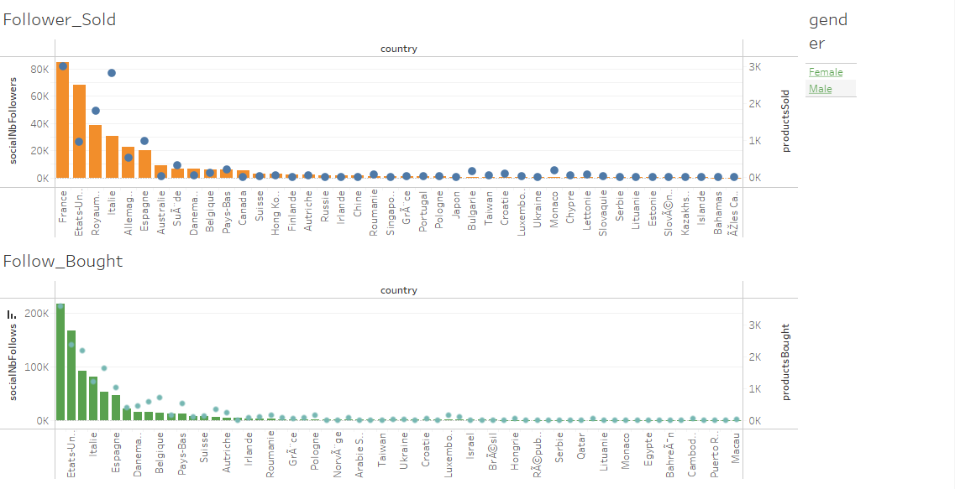

Slide 29
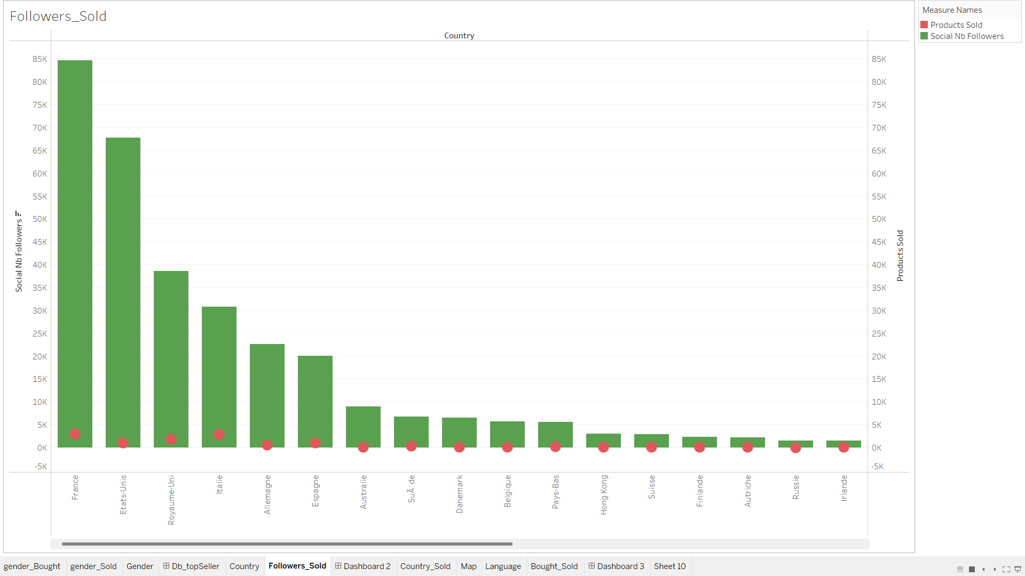
Followers_Sold Chart
This chart helps to compare socialNBFollowers and productsSold of a country

Slide 30
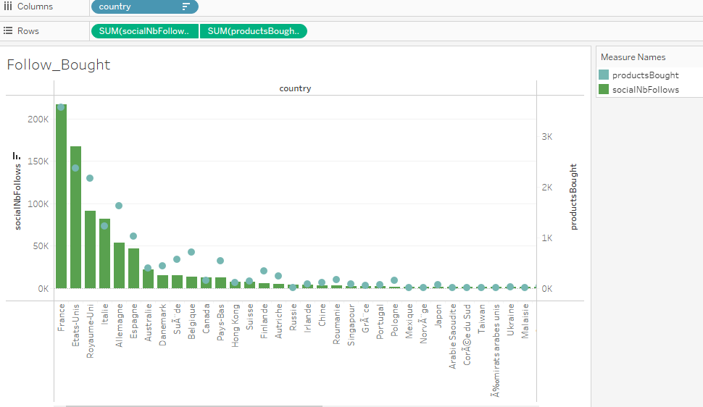
Follows_Bought Chart
This chart helps to compare socialNBFollows and productsBought of a country

Slide 31
Gender Chart
This chart is used to filter by gender

Slide 32
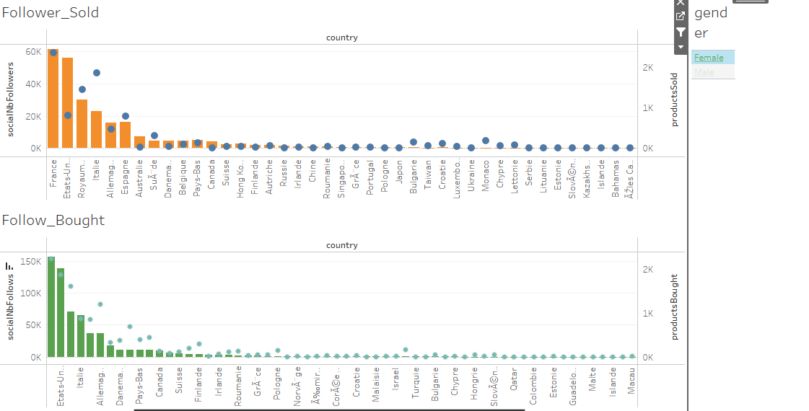
Dashboard Action
The action of this dashboard is to filter by male and female

Slide 33
Dashboard 3
This dashboard shows the countries selling in what language, the number of items sold and purchased in that language, the number of items sold and purchased filtered by language and country.

Slide 34
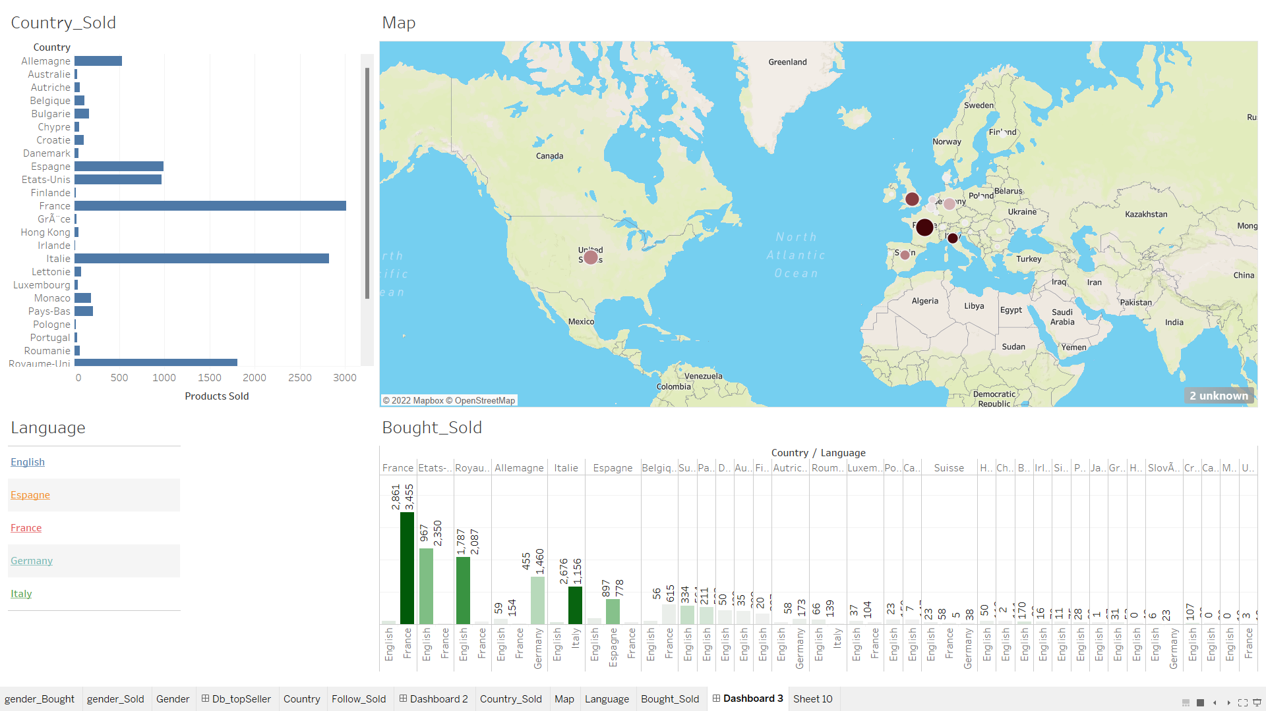

Slide 35
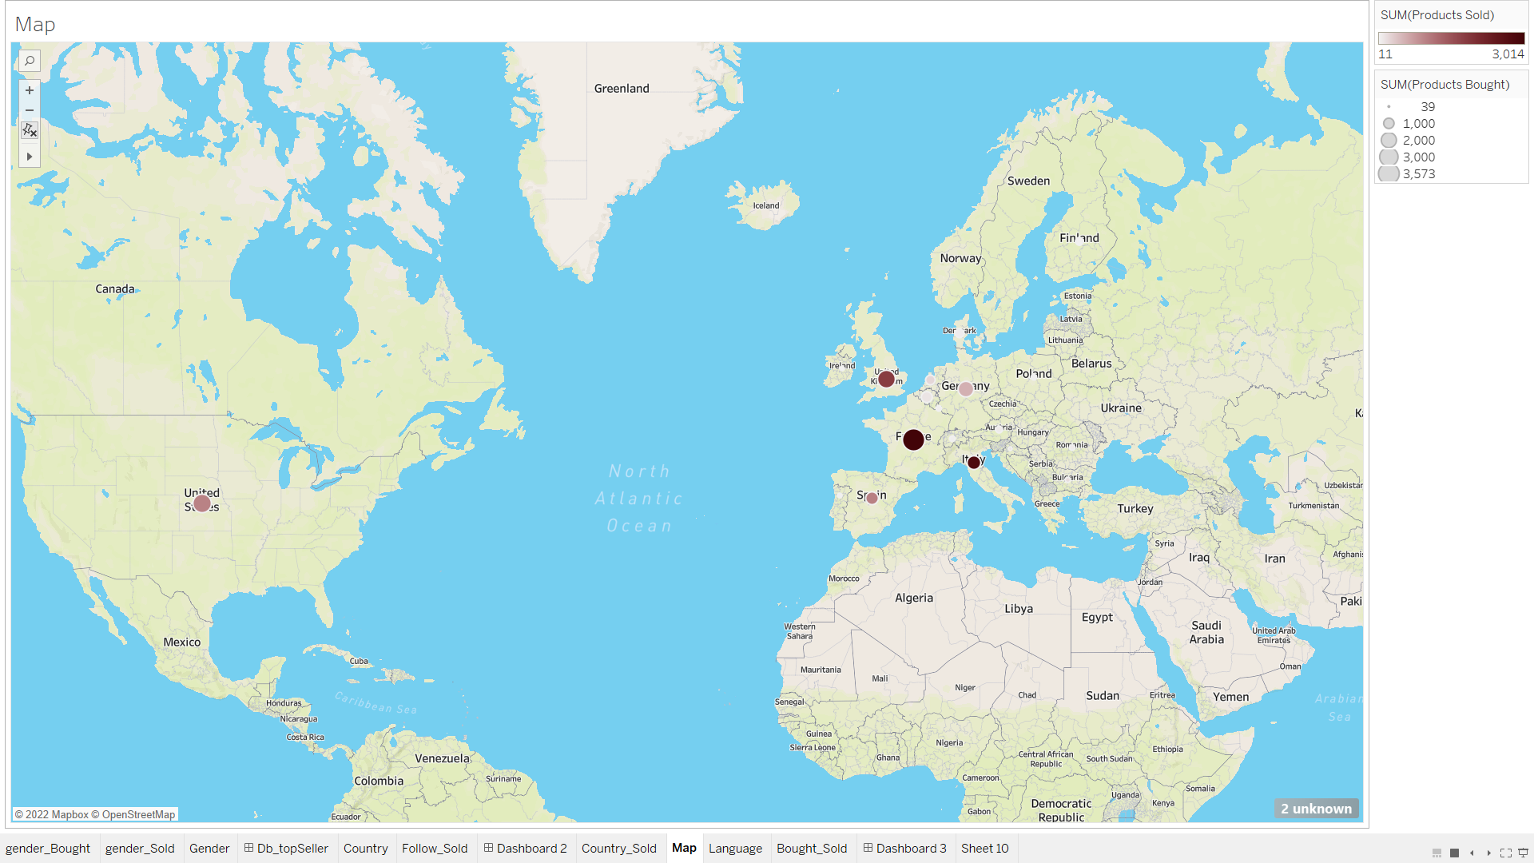
Map Chart
This chart helps to show the quantity sold and bought by countries.

Slide 36
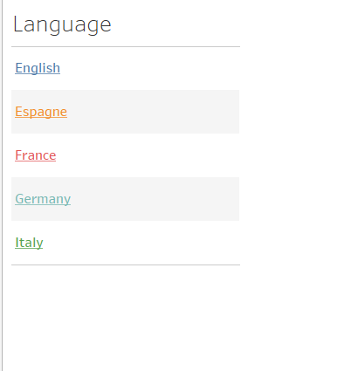
Language Chart
This chart for language filtering

Slide 37
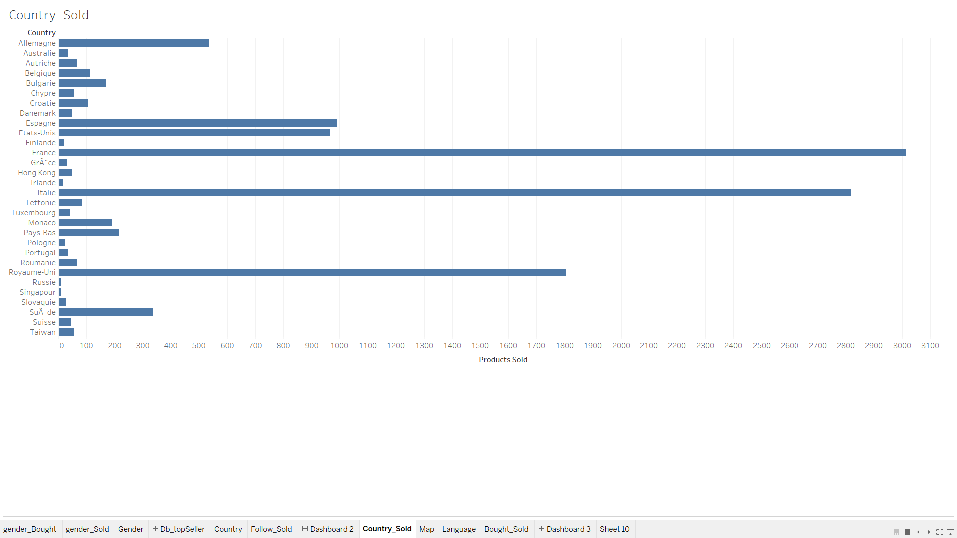
Country_Sold Chart
This chart shows the number of sales through the country.

Slide 38
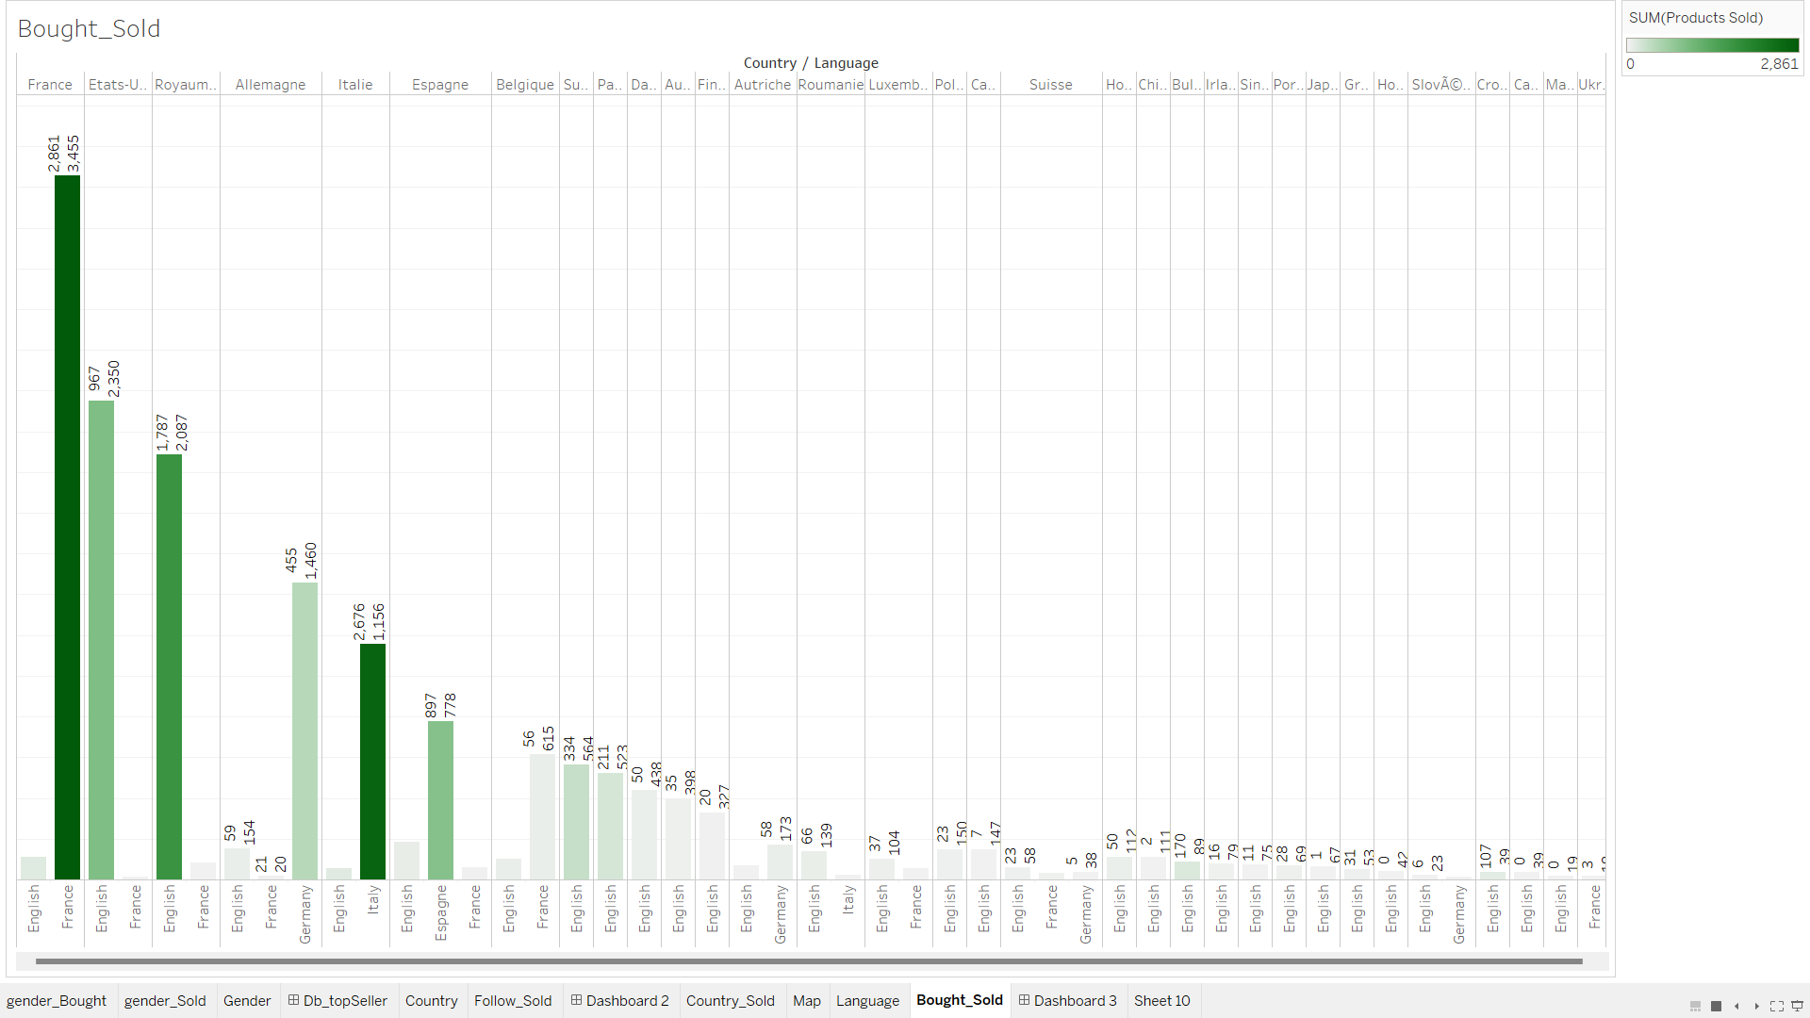
Bought_Sold Chart
This chart shows what languages are sold in and how much has been sold and bought

Slide 39
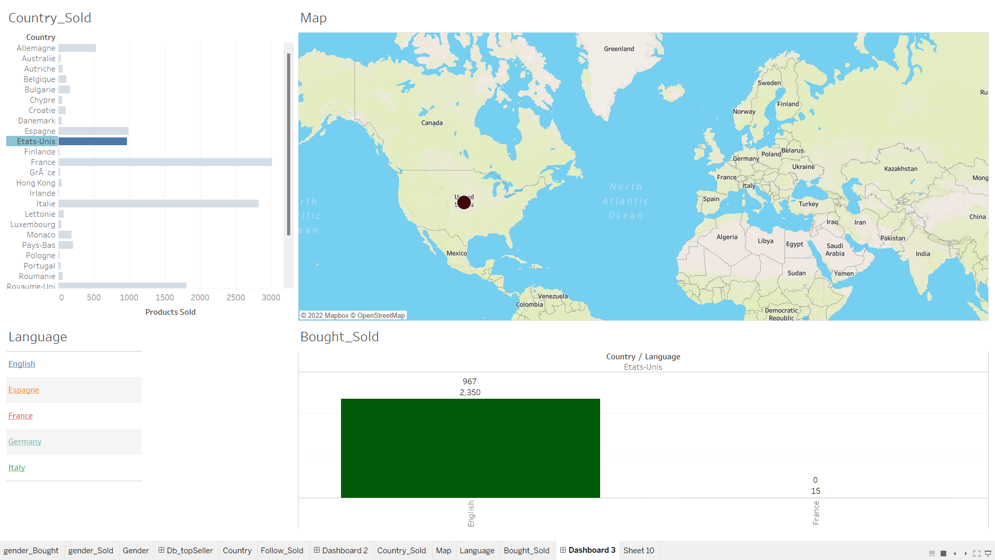
Dashboard Action
This dashboard works by selecting a country, and showing what language it sold and bought in and how much it bought and sold

Slide 40
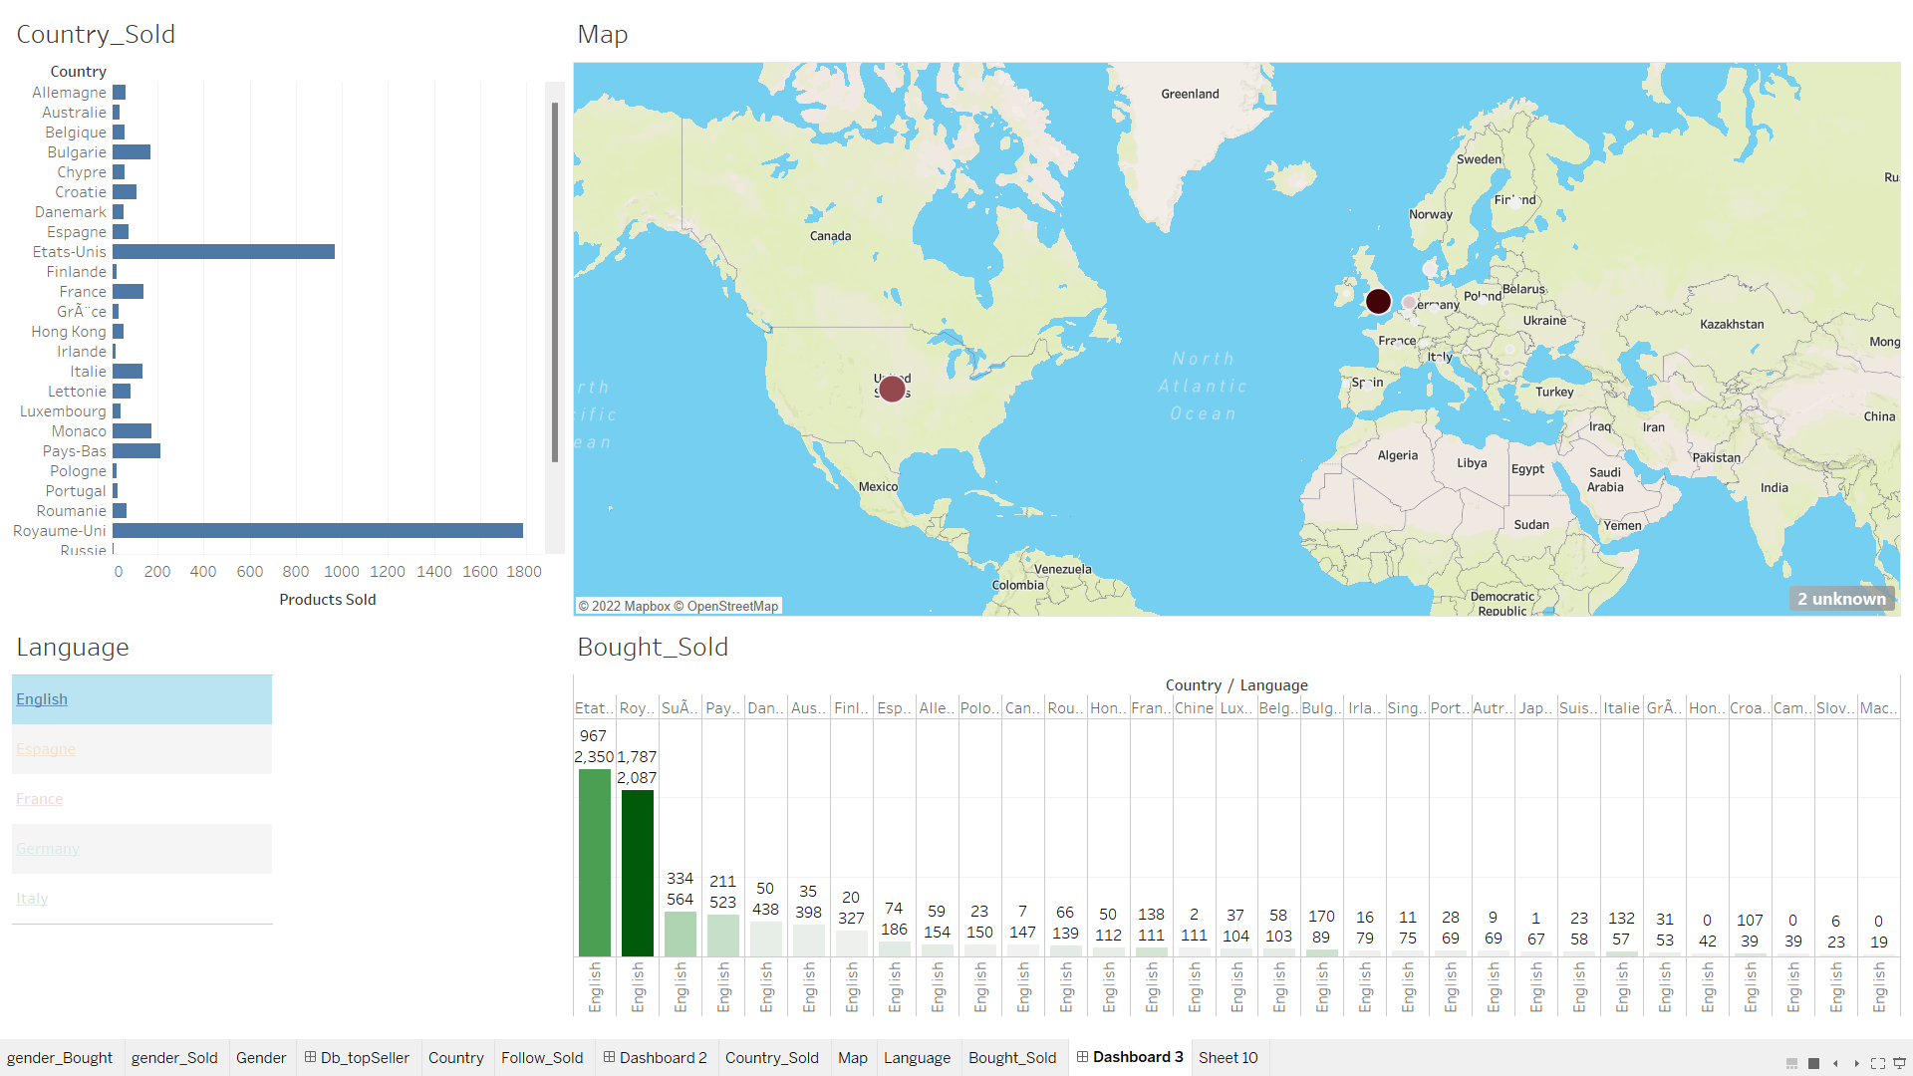
Dashboard Action
The operation of this dashboard is to filter by countries of sale according to the selected language

Slide 41
Dashboard 4
This dashboard productsListed and productsSold, gender, country, productsBought, productsWished. This dashboard compare the number of products added to the cart and the number of products purchased by gender of the countries. Accordingly, I also compare the number of products that have been updated but not yet sold and the number of products sold by gender of the country. I will filter the data by gender.

Slide 42
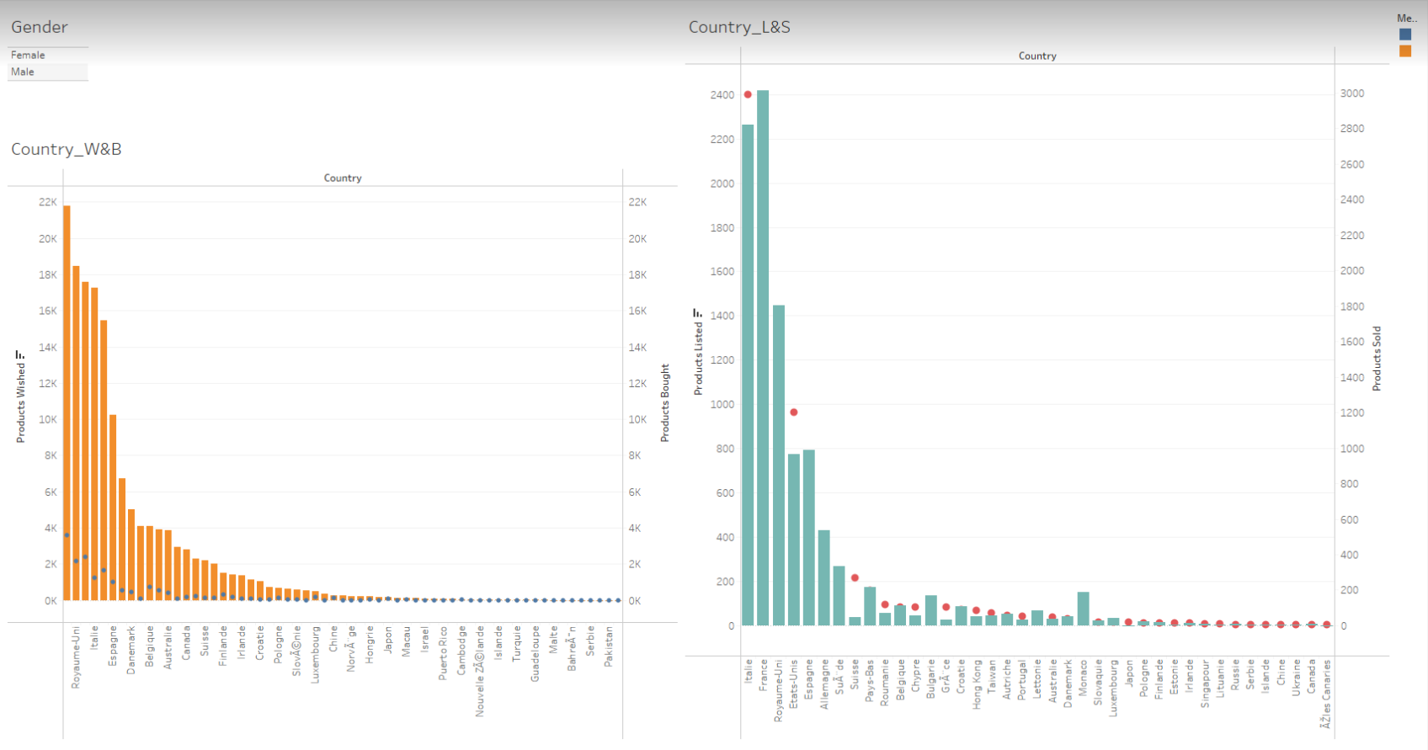

Slide 43
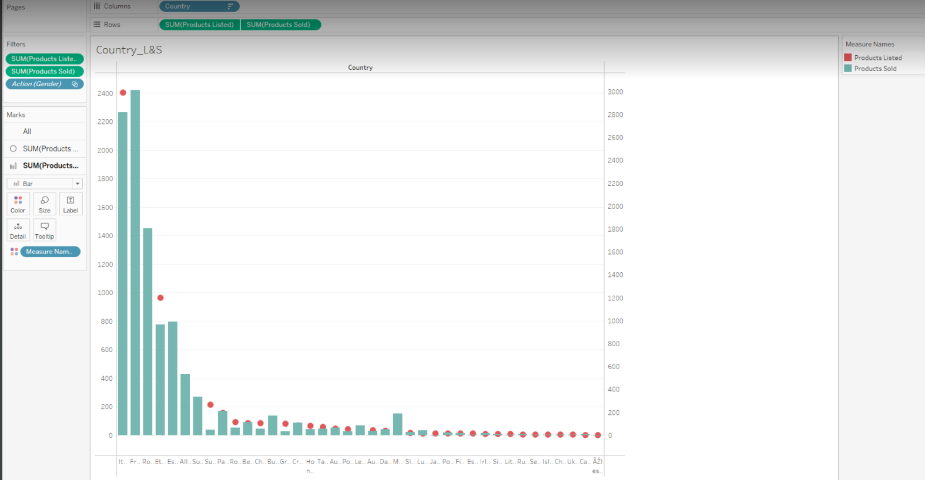
Country_L&S Chart
This chart helps to compare productsListed and productsSold of a country

Slide 44
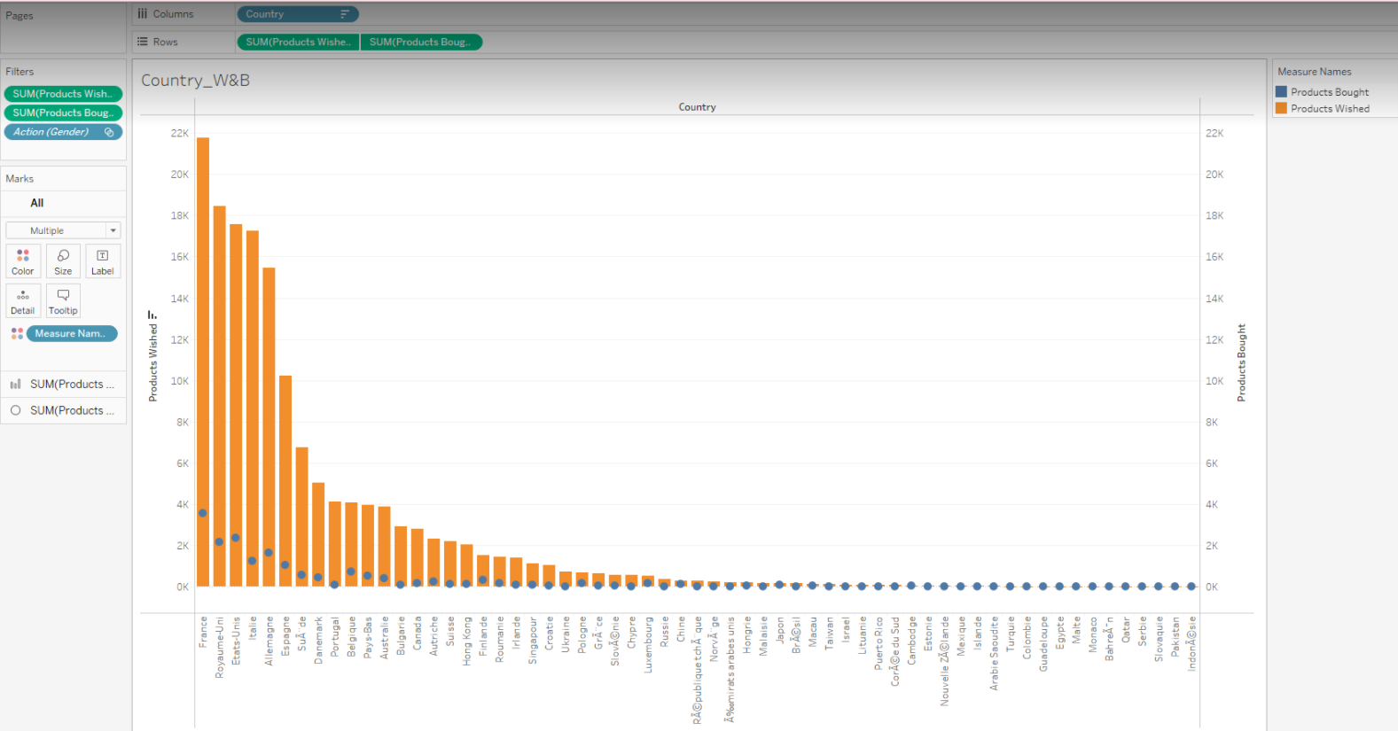
Country_W&B Chart
This chart helps to compare productsWished and productsBought of a country

Slide 45
Gender Chart
This chart is used to filter by gender

Slide 46
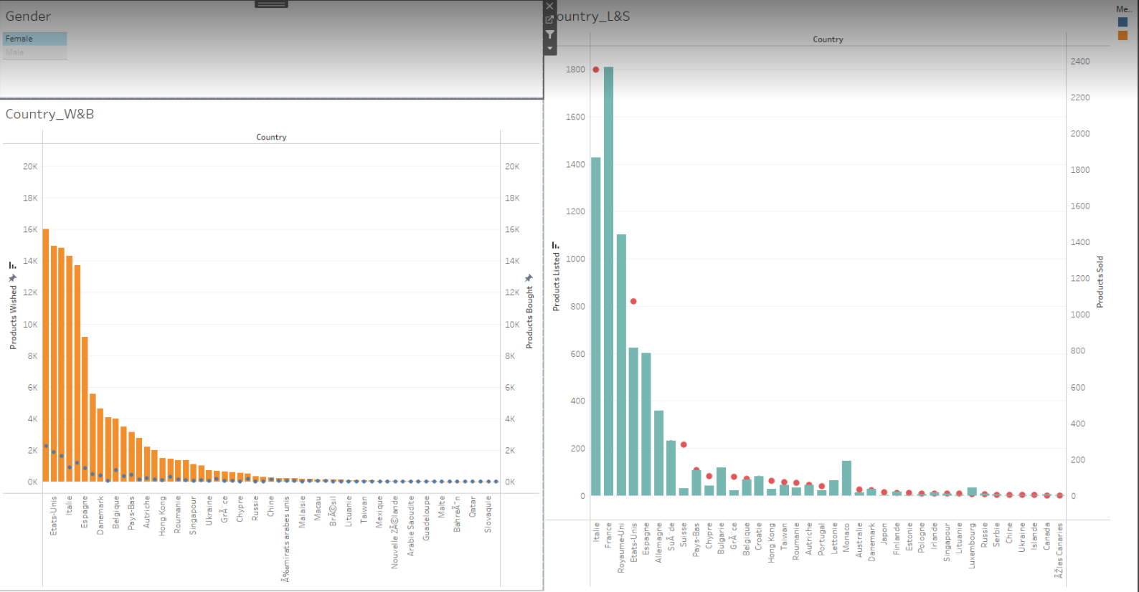
Dashboard Action
The action of this dashboard is to filter by male and female

Slide 47
Point of view
For our company apply BI to collect the number of products sold by a country and the number of currently unsold products that has uploaded. From there, if the number of products sold is high and the number of unsold products is low, we will increase the number of items in that country. When the number of products sold is low but the number of unsold products is high, we will reduce the number of items in that country. Thanks to this BI tool we can assess the market needs of the countries. Thereby providing the essential needs of items to increase sales productivity and develop e-commerce.

Slide 48
Discuss the legal issues
On legal issues related to the exploitation of user data for business intelligence. Today, customer information is collected, stored and used by many organizations and individuals to serve a variety of purposes such as product marketing, market research, etc. As a commodity for sale. At the same time, there are now many threats to users' personal information in e-commerce. For example, unauted use, illegal trading, even fraudulent appropriation of property.
If the organization collects customer data and uses technology to turn data and analytics into actionable insights, important business decisions will be easier and sales will improve. Smart business is not only about collecting and storing data, but also testing, analyzing and exploiting it to improve operations. It is perfectly legal to do so.
If the company collects customer data to sell or usurp personal information. That's illegal.
Therefore, at present, in the world, there are two basic trends: Promulgating common laws such as EU, Japan,…; Issued together with the prevailing laws such as in Vietnam and the US.
In conclusion, it can be seen that each region and country has its own tendency to regulate laws on issues of protecting users' personal information in e-commerce. It depends on the conditions, situation, economic, political and cultural needs of the country or region itself.

Slide 49
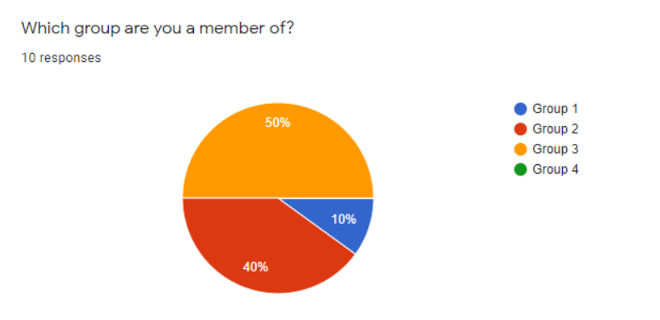
Feedback from other students after watching the presentation
We have obtained reviews from students of other groups, in which group 3 accounts for the most 50%, the least is group 1 with 10%.

Slide 50
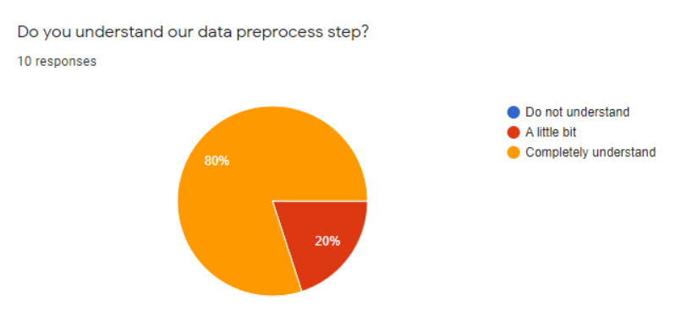
Feedback from other students after watching the presentation
According to the survey, the number of students who feel understanding about our data preprocess step accounts for 80% and 20% of the students feel a little understanding. Especially, there is no student who does not understand about our data preprocess step. That proves that our team has handled our data preprocess step very well.

Slide 51
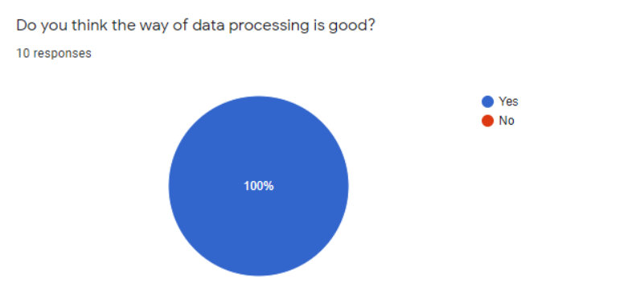
Feedback from other students after watching the presentation
100% of students feel that the way of data processing is good. That shows that my team has handled the data very well.

Slide 52
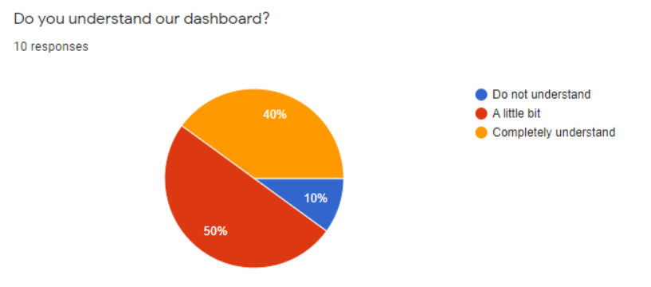
Feedback from other students after watching the presentation
According to a survey, 40% of students feel that they understand our dashboard. However, the number of students who feel a little understanding makes up 50% and 10% of the students feel that they do not understand our dashboard. That said, our dashboard is really not good when the percentage of students who know the dashboard is only 40%, less than half of the students. Therefore, we will have to improve the dashboard handling in the next time.

Slide 53
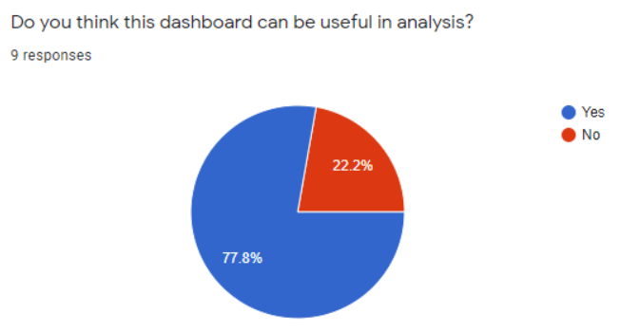
Feedback from other students after watching the presentation
According to the survey, the number of students who feel the dashboard can be useful in analysis accounts for 77.8%. That shows that we have also used the data in a reasonable way to make it easier to analyze. However, the number of students who felt the dashboard can not be useful in analysis accounted for 22.2% because we had dashboards that didn't make much sense and couldn't extract much information. We will improve this skill in the future.

Slide 54
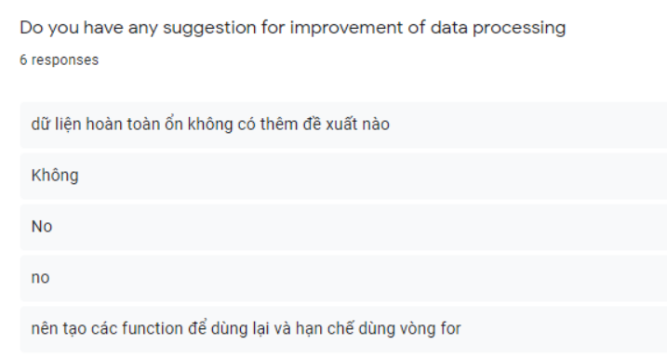
Feedback from other students after watching the presentation
According to the group survey I obtained, most students feel that our data processing is very good. Besides, there are some opinions that our team should use functions for the code instead of using multiple for loops. That we will improve in the future.

Slide 55
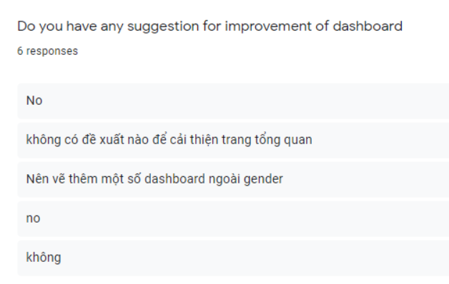
Feedback from other students after watching the presentation
Most students feel our dashboard is fine, however, because we use gender column many times in many dashboards, it makes our analysis data not rich. Our team will improve this in the future.

Slide 56

Thanks For Watching!

Slide 57
Reference
https://www.guru99.com/business-intelligence-definition-example.html
https://dataintegration.info/business-intelligence
https://quantrimang.com/python-la-gi-tai-sao-nen-chon-python-140518
https://tino.org/vi/tableau-la-gi/
https://dataintegration.info/business-intelligence

